Slide 1

Fudgemart, Inc. Business Intelligence & Data Warehouse Solution
Tory L., Daniel P., Nebe S.
DATA WAREHOUSE IST 722
Syracuse University

Slide 2
Contents
Overview
Project Planning
Business Requirement Gathering
Design
Deployment
Business Intelligence
Q&A

Slide 3

Project Planning
Fudgemart Inc.

Slide 4
Business Case
Fudgemart and Fudgeflix are two subsidiaries of Fudgemart Inc. The business needs a Data Warehouse to manage the merging of two separate databases and create a data warehouse for business intelligence reporting. This will allow the newly formed business intelligence and business analytics teams to provide proper information on business needs and issues.

Slide 5
Project Objectives
Requirements Gathering
Create and Build a Data Warehouse
Profiling Data
BI solution for Fudgemart, Inc.

Slide 6
Milestones & Deliverables
Milestones
Deliverables
Initiating | Executing
1. Project Charter / Project Plan Doc | 5. Initial ETL/SQL
2. High – level dimensional model | 6. Business Intelligence
3. Detail-level dimensional model | 7. Project Closure
4. DW SQL Implementation | 8. Final Presentation
1 | Project Charter
2 | High-level dimensional modeling worksheet
3 | Detail-level dimensional modeling
4 | SQL Script
5 | Artifacts

Slide 7
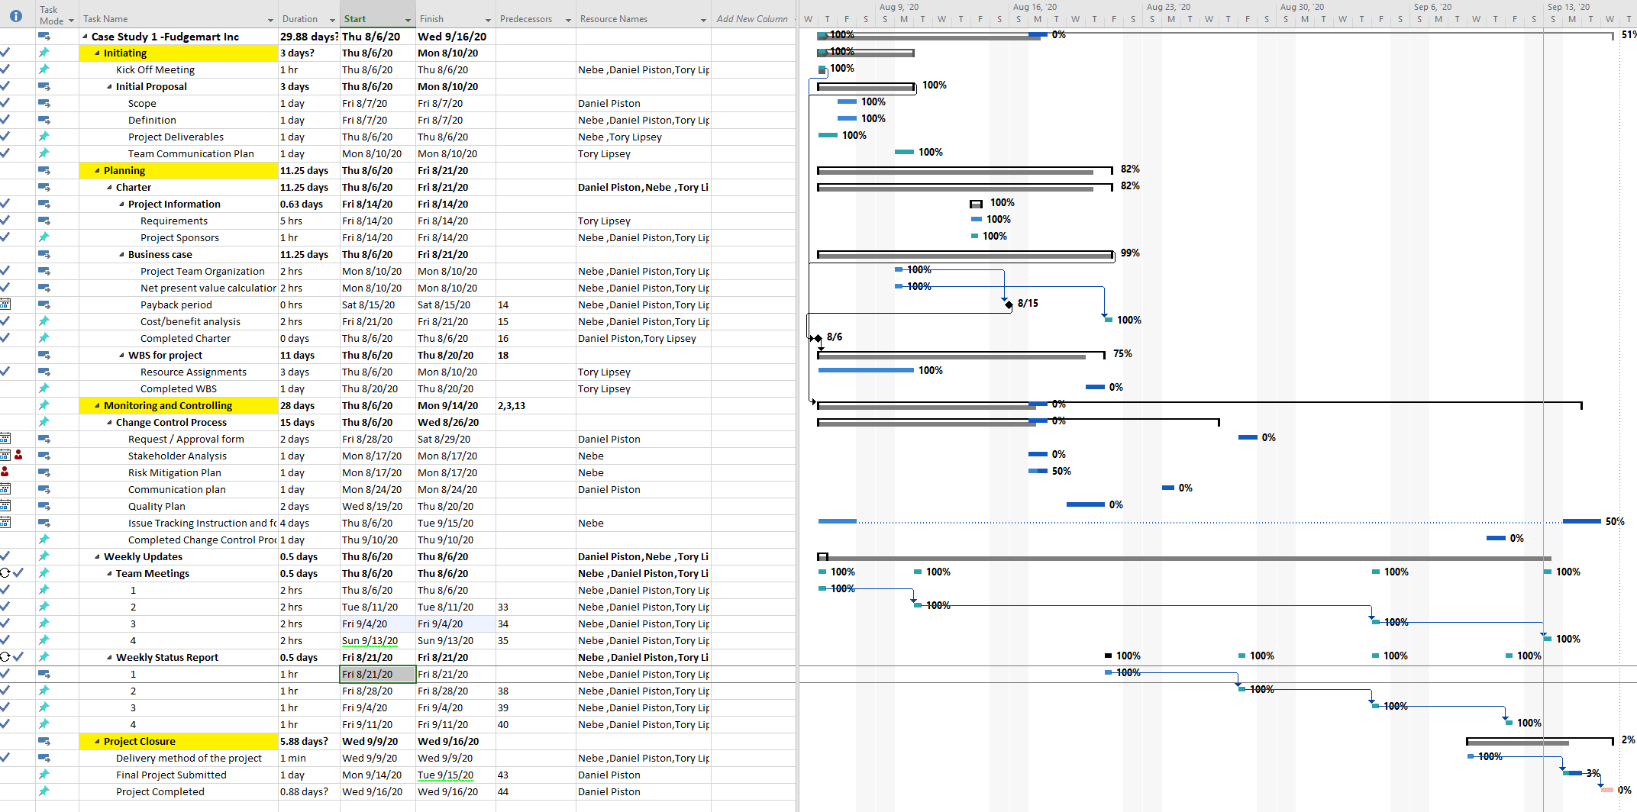
Project WBS

Slide 8

Business Requirement Gathering

Slide 9
Functional Requirements
Analyze Fudgemart Orders
Analyze if the Customer belongs to Fudgemart or FudgeFlix for offers selection
Business Users can analyze if the customer has Fudgemart account but not Fudgeflix, then provide them promotional offers
Business users can analyze customer orders by order dates, shipped dates, product quantities, order totals
Analyze increased business and growth opportunities across locations
Forecast product supply chain by location based on historical data

Slide 10
Business Process
Order Fulfillment
Sales
Customers
Ratings
Employee Time

Slide 11
Justifications
The project is focused on creating a centralized data warehouse repository that consists of aggregated data coming from different subsidiaries.
The data will be stored in a series of snapshots/views, in which each record represents data at a specific time. By analyzing the snapshots, one can compare among the time periods. These comparisons can help the user make important business decisions.
The data warehouse databases provide a decision support system in which a user can calculate and evaluate the performance of the organization over time.

Slide 12
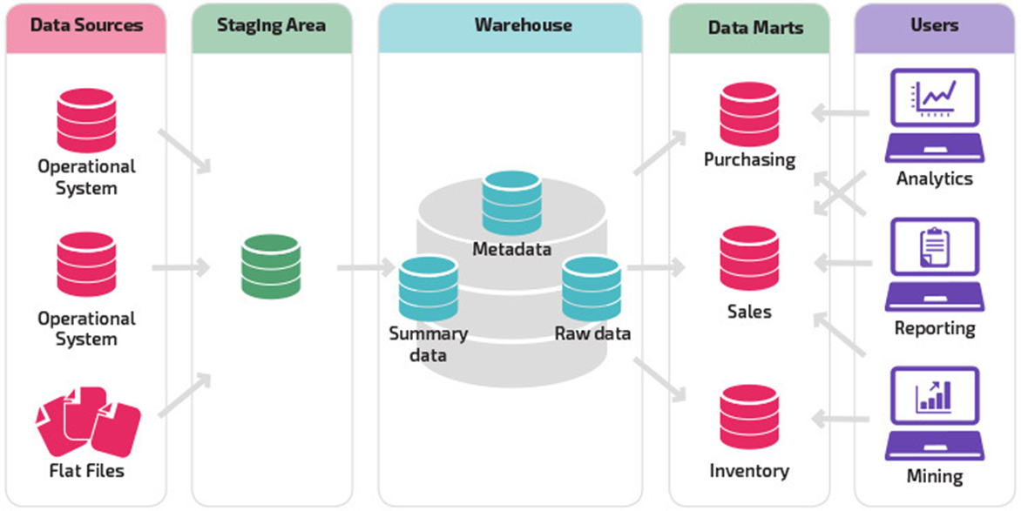
Data Warehouse Design

Slide 13
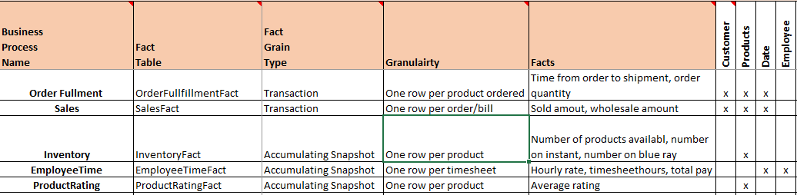
Bus Matrix

Slide 14
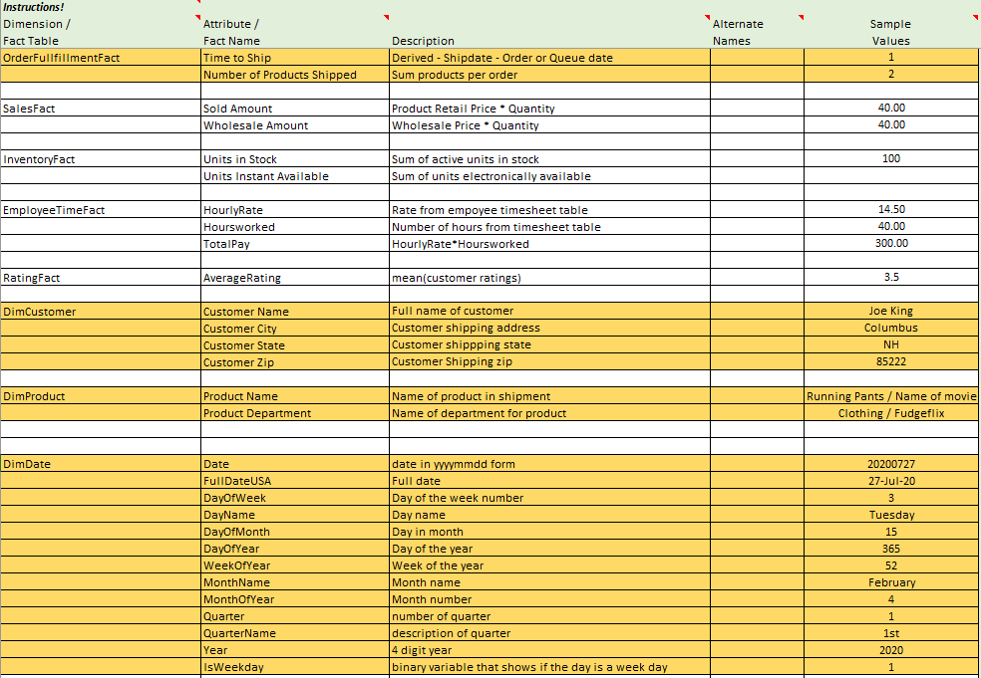
Attributes & Metrics

Slide 15
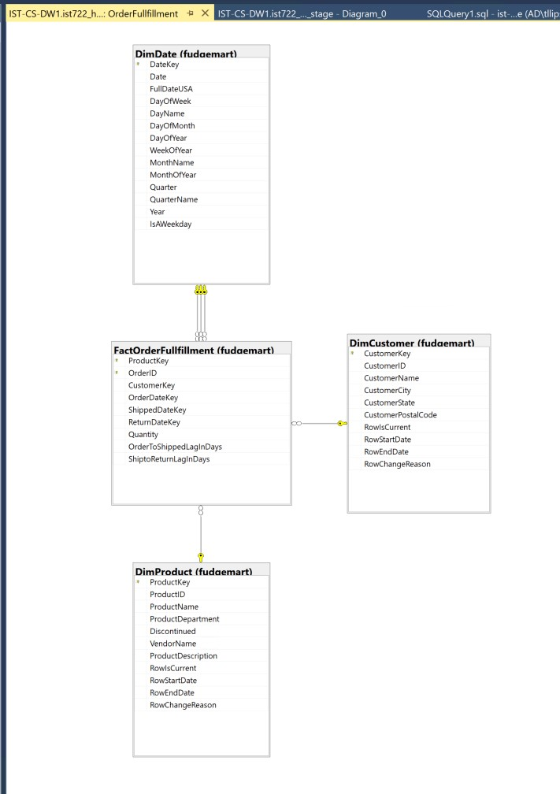
Star Scheme SQL Server

Slide 16
ETL Methodology
ETL Tool: SQL Management Studio
Data staged as is, except for where data was missing.
If corresponding columns were missing from source they were added in stage
Ex. Return date column for FudgeMart
Joins were done in staging to get all of the columns needed
Dates selected in years to match data
All data transformation was done from stage to load
Concatenation of columns
Fact table calculations
Data type transformations
Ex. Product IDs

Slide 17
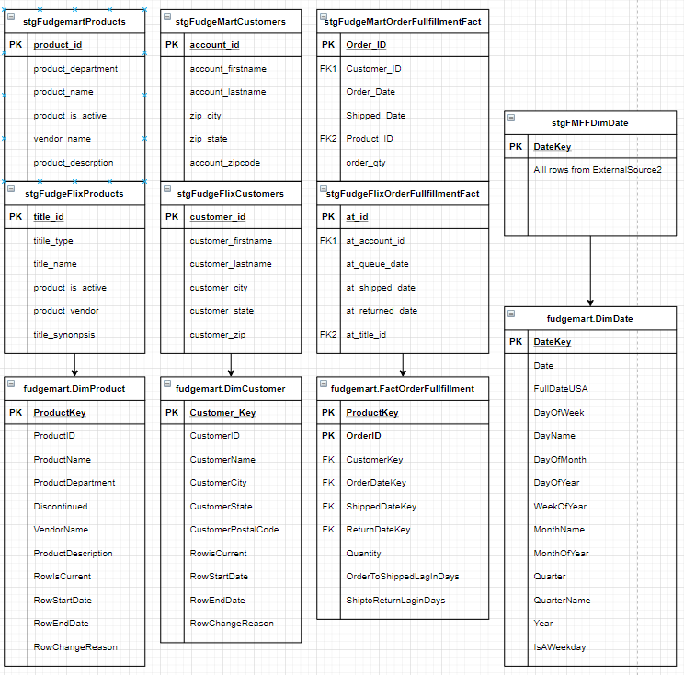
Flow of Data
Two staging tables, one for each data source
Aligned columns with the same business information (ex. Product department and title type)
Loaded each table into the DW table

Slide 18
Issues List
Aligning data types between two sources and into the data warehouse
Collation issues in SQL Management Studio between columns during the data manipulation
Null value in the date table founding during BI
Different columns from different sources, data missing

Slide 19

Execution

Slide 20
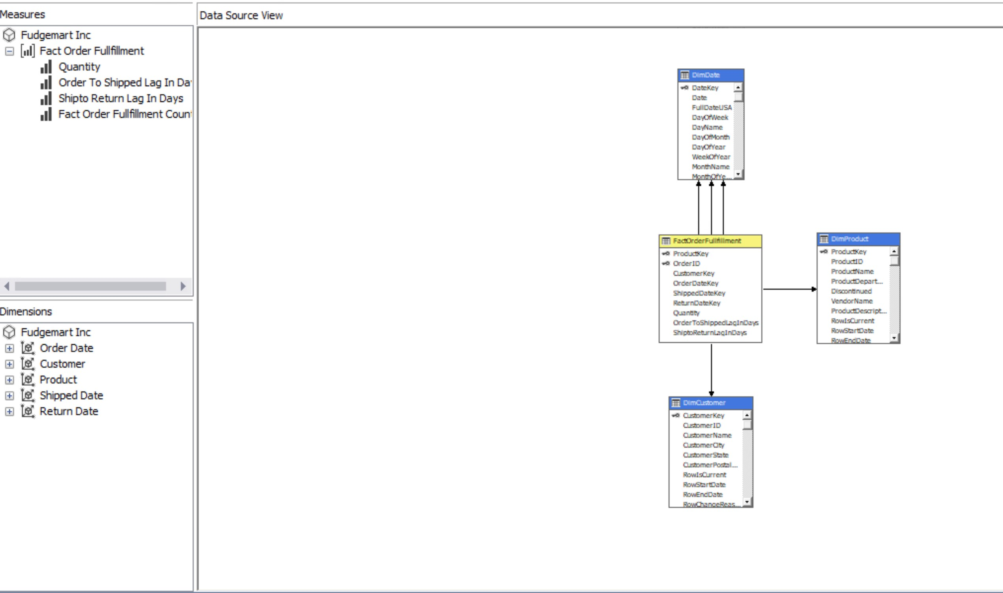
The Cube

Slide 21

Business Intelligence Design

Slide 22
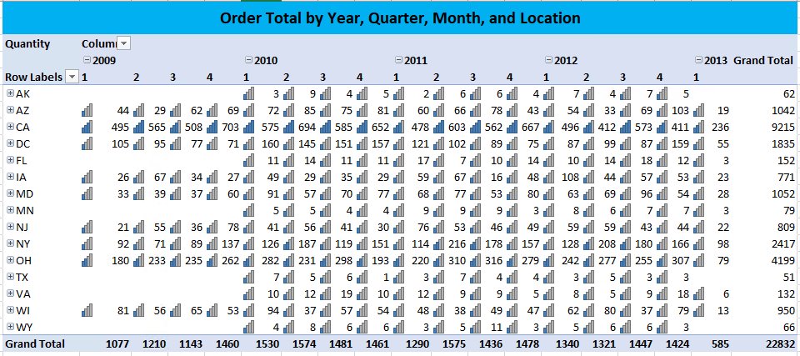
Excel to ROLAP
1. Order Total By Year, Quarter, and Month

Slide 23
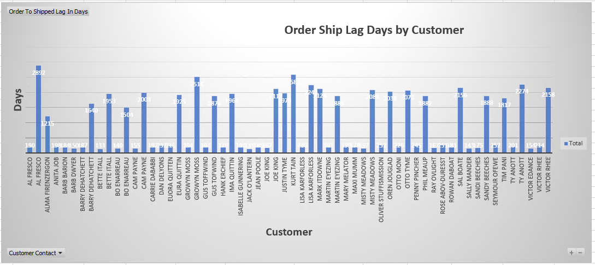
EXCEL to MOLAP
2. Order Ship Lag Days by customer key

Slide 24
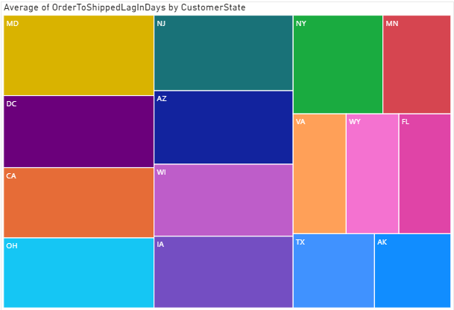
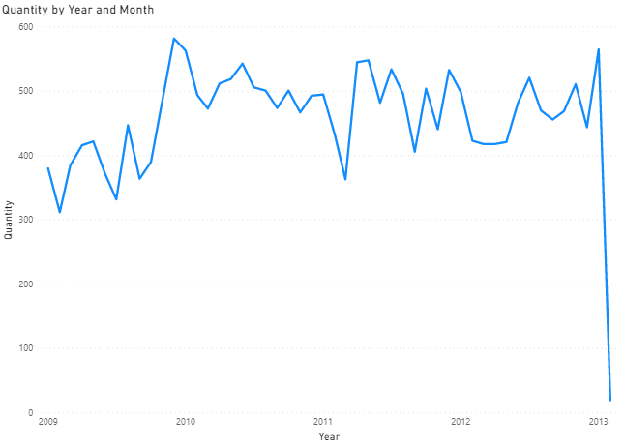
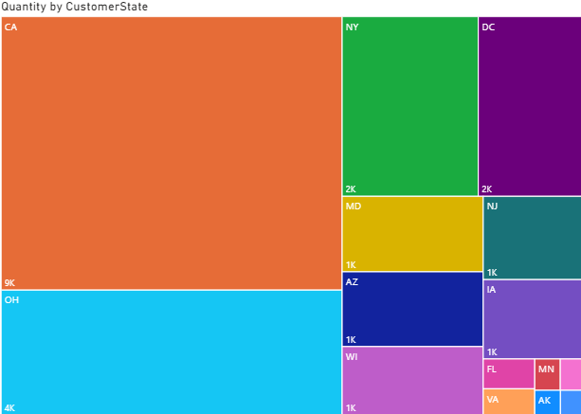
Power BI

Slide 25
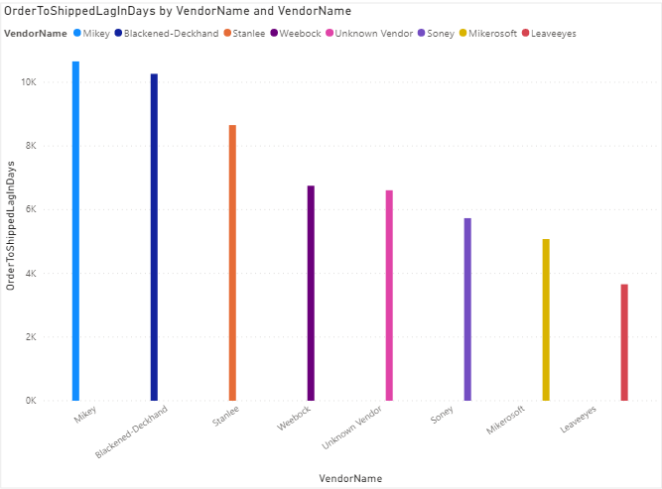
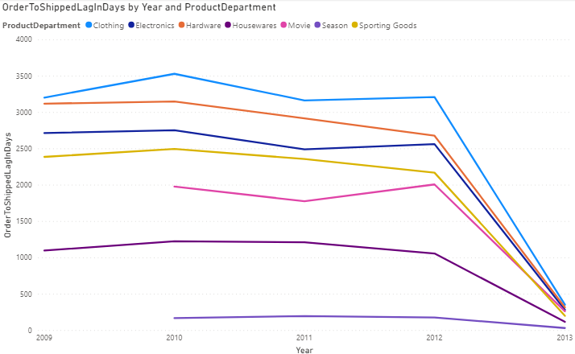
Power BI to MOLAP

Slide 26
Summary & Lessons Learned
Conclusion
This newly formed central repository i.e. data warehouse is summarized data coming from
various sources, without loss of any valuable information which is used for better decision
making across the organization.
Lessons Learned
Build KPI’s in SSIS
Reevaluate how we structured the data

Slide 27
Q&A

